Slide 1
Smithgall Woods Park Website
Project Update
MIST7591E – MBT Project II
Andrea Castresana
Jennifer Lazo
Alexander Couch
Clark Williams
Eliseo Santos
January 24, 2018

Slide 2
Overview
Project Background
WordPress Theme Selection
Available Plugins & Limitations
Alternative Solution to Volunteer App
Project Schedule
Way Ahead

Slide 3
Project Background
Problem
Difficult to update/maintain site and Volunteer app
Outdated PHP, WP themes and plugins
Degraded site security
Solution
Rebuild site using current WordPress/PHP
Site hosting either 1&1.com or Bluehost
Establish detailed Admin Documentation
Train FSGW Reps
Notes:
Criteria for website hosting:
Code must be accessible and portable
Cost must be below $20
Site security must be include SiteLock and SSL Certificate

Slide 4
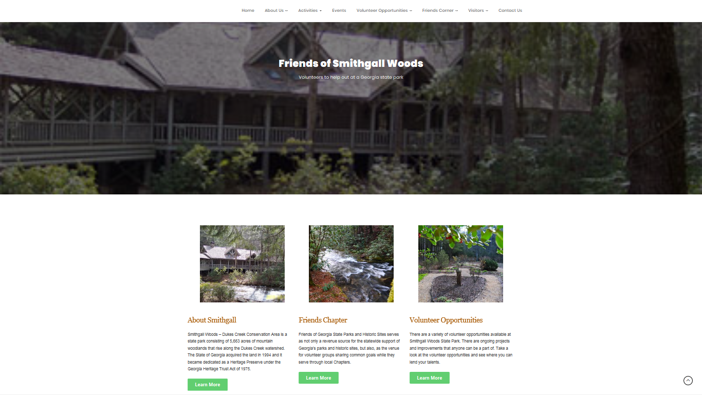
WP Theme Selection
Krystal – Free WP Theme

Slide 5
Available Plugins & Limits
Most plugins use the built-in WP Database
Non-customizable database tables
Will not allow migration of the app DB tables
Negative impact to Volunteer App & Reports App

Slide 6
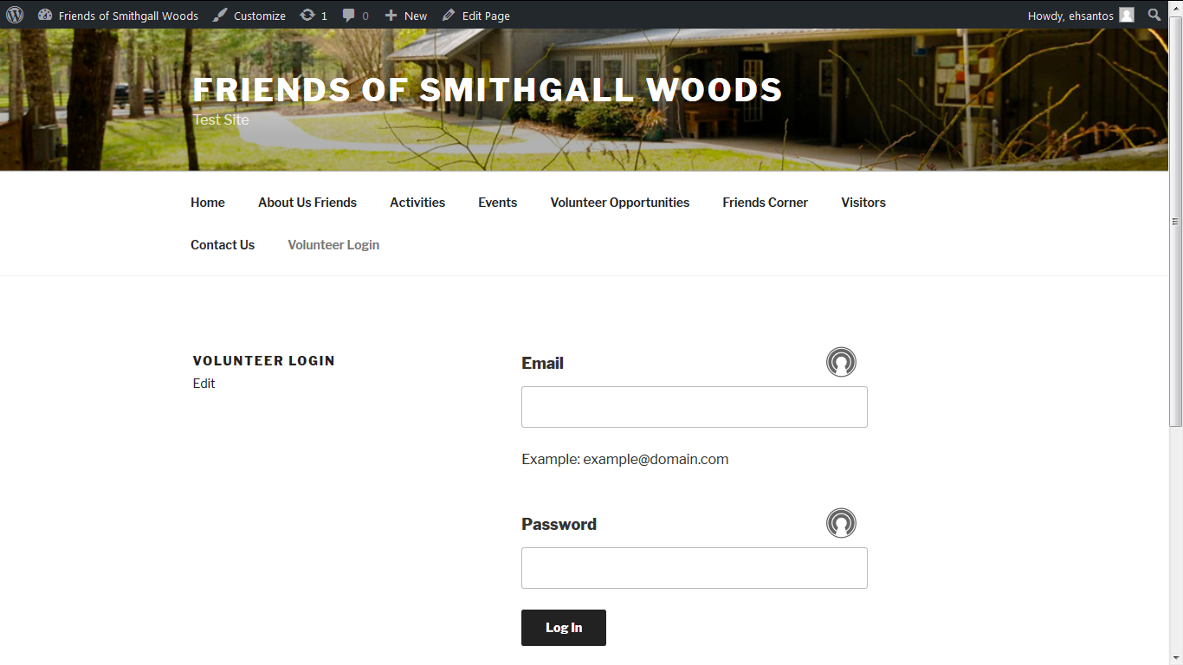
Alt. Solution to Volunteer App
Embedded Login Page on Example Theme

Slide 7
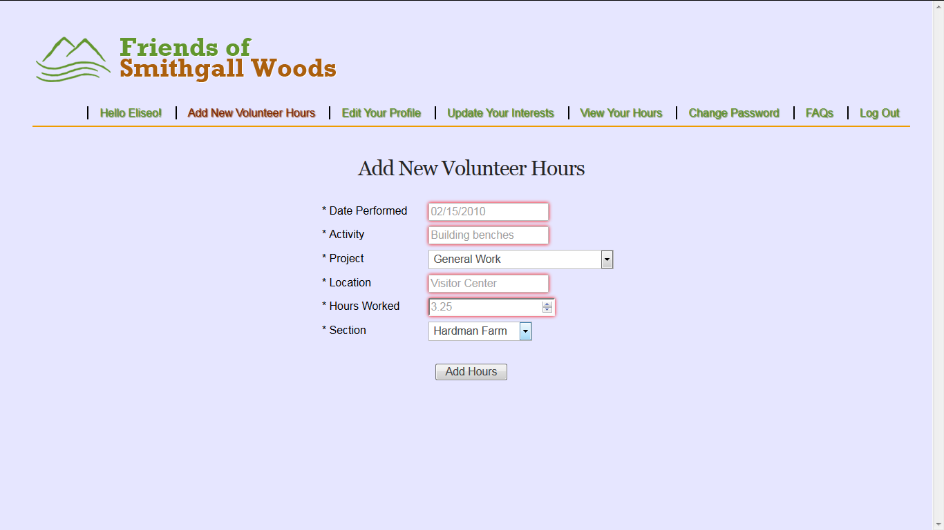
Alt. Solution to Volunteer App
Added Section Field for Hardman Farm & SGW

Slide 8
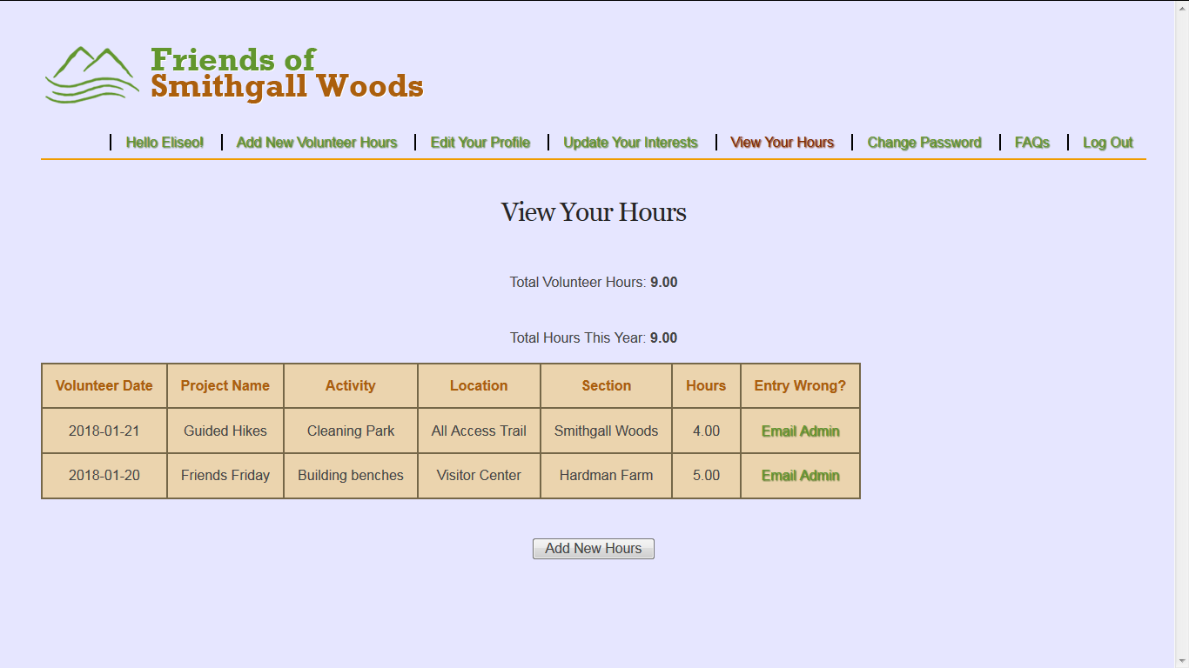
Alt. Solution to Volunteer App
Volunteer Hours View

Slide 9
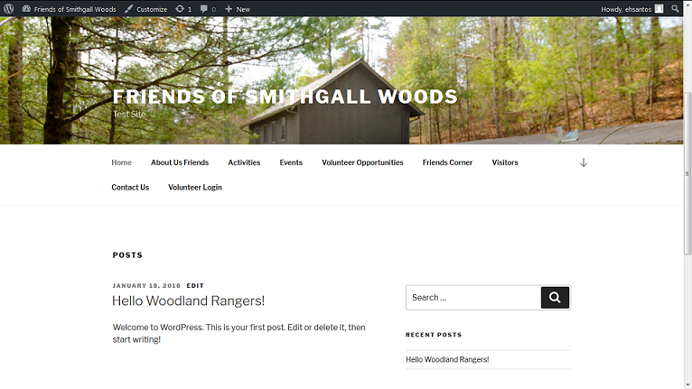
Alt. Solution to Volunteer App
Returns to Home Page after Log Out

Slide 10
Project Schedule
 |  | CY2017 |  |  |  | CY2018
Task Phase | Task Description | S | O | N | D | J | F | M | A
Initiation & Planning | 1. Conduct System Analysis of Current Site
 | 2. Propose Security Remediation Plan
 | 3. Establish Proposed System Requirements
 | 4. Meet with Project Stakeholders
 | 5. Develop Logical Models
 | 6. Conduct Testing of WordPress / Prototype
 | 7. Research Web Content Management Tool
 | 8. Finalize Requirements & Project Charter
Project Execution | 9. Start Rebuilding the Website/Volunteer App
 | 10. Test First Increment Version of Site/App
 | 11. Finish Rebuilding the Entire Site/App
 | 12. Test Final Rebuild of Website/App
Project Closure | 13. Establish Documentation
 | 14. Deploy Production Version of Website
 | 15. Conduct Training on Website Maintenance
 | 16. Hold Project Closure Meeting with Client

Slide 11
Way Ahead
Continue customizing site content with theme
Update Volunteer app code to PHP 7.2
Resolve MySQL deprecation by using MySQLi or PDO_MySQL extension
Notes:
Train all team members on WordPress & PHP
Tutorials by LearnWebCode & Lynda.com
Assign site rebuilding tasks to each team member; rebuild is consisted of 3 parts
Main SGW Website
Volunteer Hours Log App
Volunteer Reports App (Secondary site)
Begin rebuilding website in December

Slide 12
Questions

